Slide 1
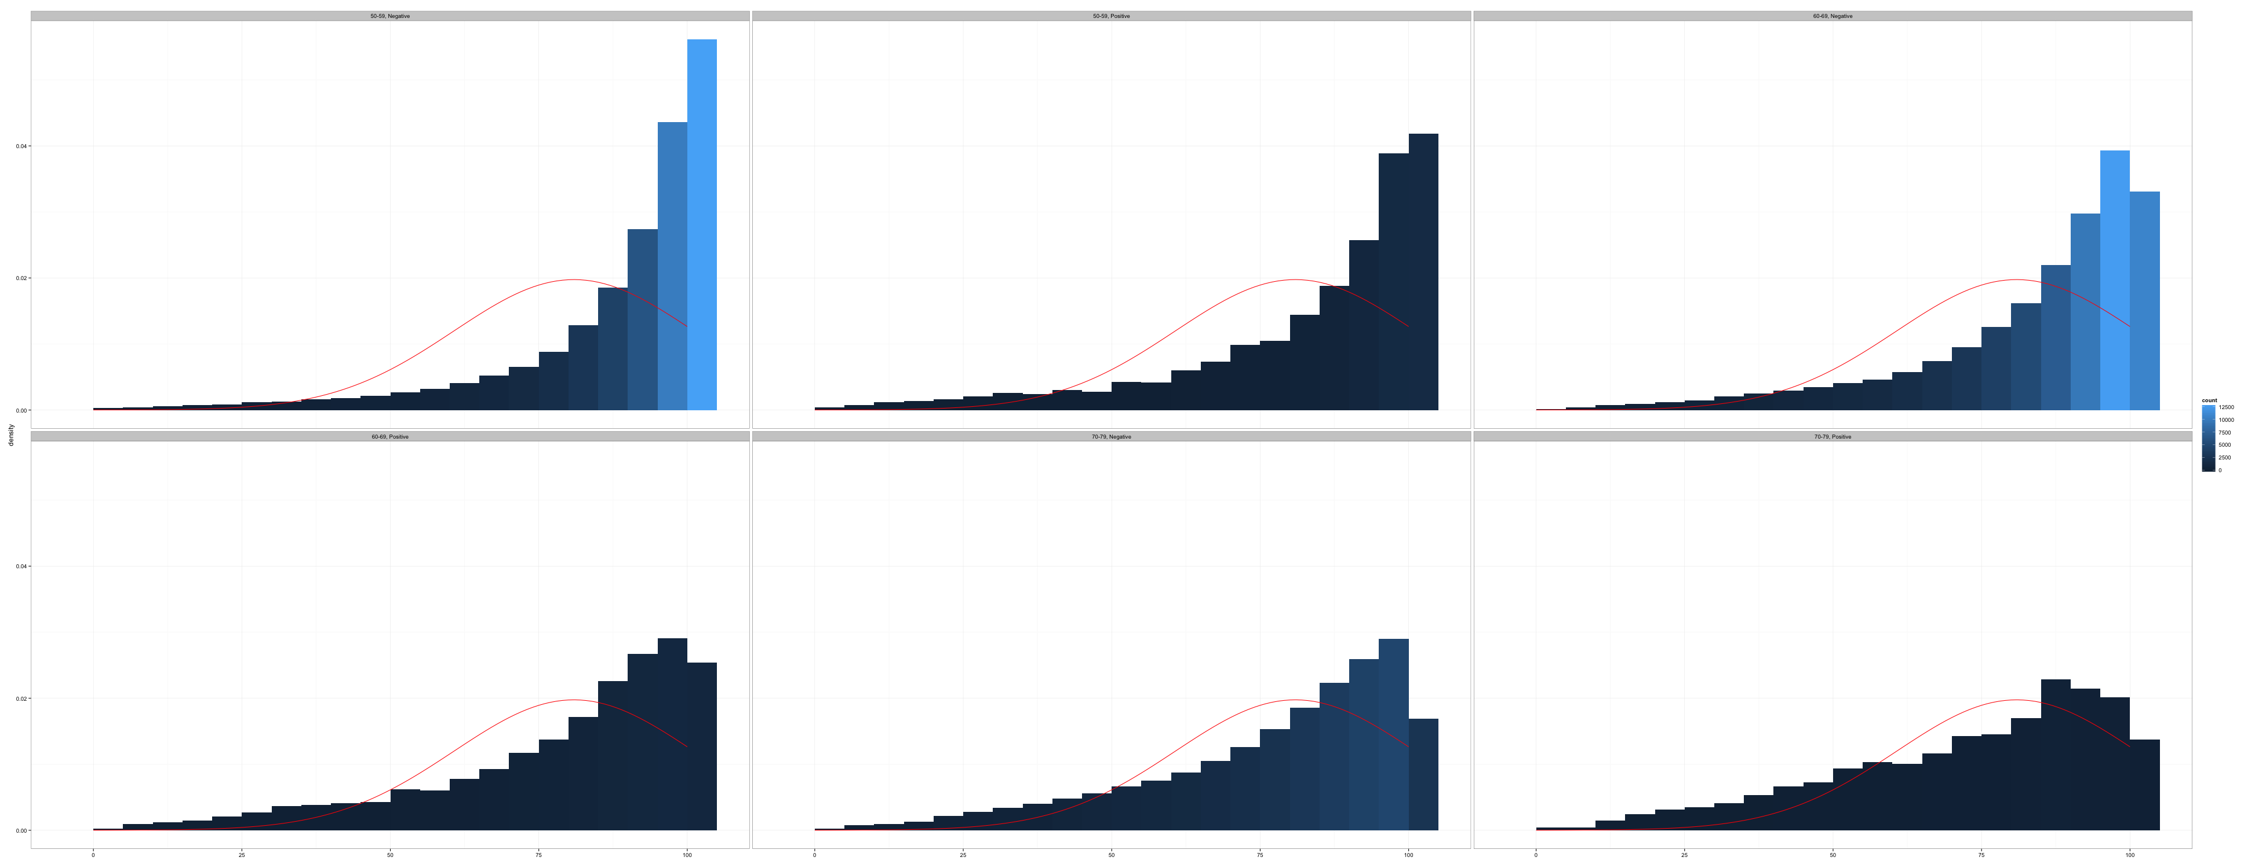
Managing Skip Patterns
Introduction to Data Management and Statistical Computing
Notes:
In this video we’re going to discuss skip patterns in surveys. We’ll begin with a brief overview of what skip patterns are.

Slide 2
What should you do about skip patterns?
Notes:
Now that you know why skip patterns are important, and how to identify them, let’s talk about what you should do to appropriately account for them.

Slide 3
What should you do about skip patterns?
Data management
Data checks
Notes:
You will start by implementing some of the basic conditional processing techniques we’ve already discussed in this course, and then follow-up with some simple data checks to make sure everything turned out the way you expected.

Slide 4
Demonstration
Manage skip patterns in a DATA step
Notes:
I’ll demonstrate both next.

Slide 5
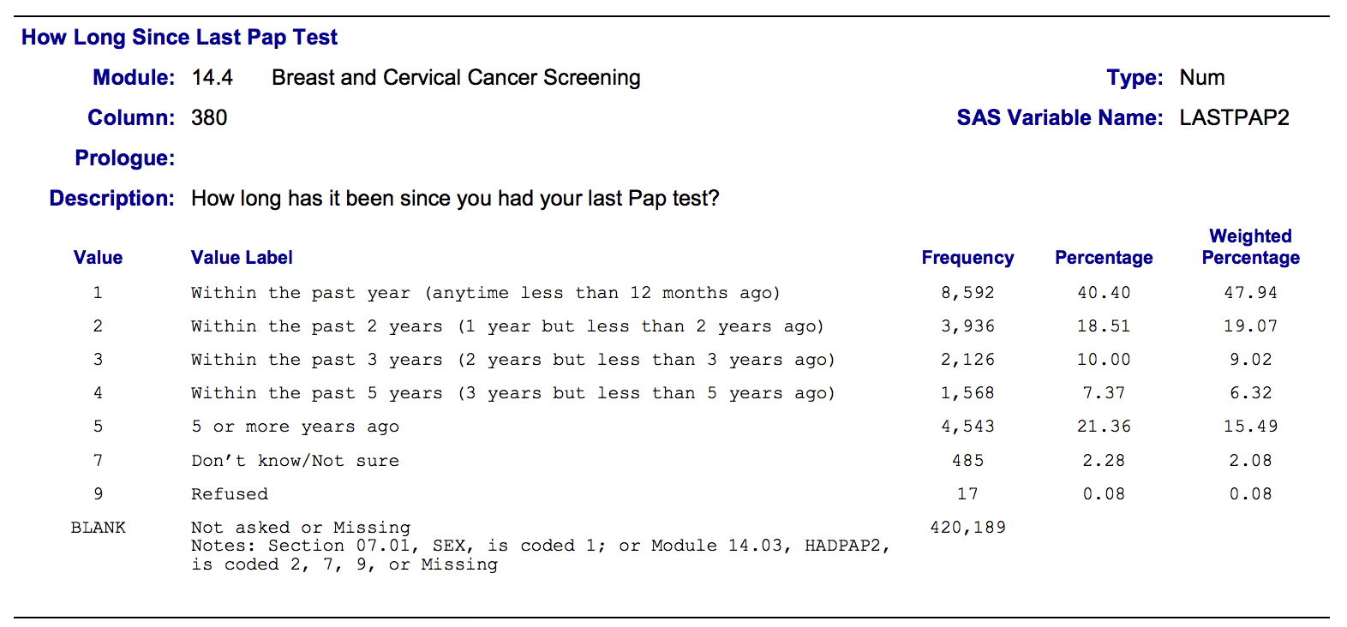
Notes:
For this demonstration, we’re going to return to the pap test example from the BRFSS.

Slide 6
What proportion of women in the United States have had a pap test in the past 5 years?
Notes:
And we want to know the proportion of women in the United States that have had a pap test in the past 5 years. However, we haven’t yet learned to appropriately weight BRFSS data to represent the US population, so we will amend our study question a bit.

Slide 7
What proportion of women that participated in the 2015 BRFSS have had a pap test in the past 5 years?
Notes:
There. We know how to calculate the proportion of our participants that had a pap test in the past 5 years. Now let’s go through our checks.

Slide 8
What proportion of women that participated in the 2015 BRFSS have had a pap test in the past 5 years?
Notes:
Here we see our red flags for skip patterns, so we know that there’s a chance that analyzing this variable without incorporating contextual information will give us a biased answer. Now, let’s think about the context.

Slide 9
Male
What is your sex?
Have you ever had a pap test?
When was your last pap test?
Module 14.05
Female
Notes:
We actually have two questions here that impose skip logic. Let’s first think about sex. If the participant is a male, they skip over the question about ever having a pap test.

Slide 10
Male
What is your sex?
Have you ever had a pap test?
When was your last pap test?
Module 14.05
Female
id | sex | hadpap2 | lastpap2
1 | 1 | . | .
Notes:
So, they will have missing values for hadpap2

Slide 11
What proportion of women that participated in the 2015 BRFSS have had a pap test in the past 5 years?
Male
What is your sex?
Have you ever had a pap test?
When was your last pap test?
Module 14.05
Female
id | sex | hadpap2 | lastpap2
1 | 1 | . | .
Notes:
But, if we think back to our study question, we don’t care about males. It wouldn’t make sense to include males in this analysis, so we are happy to leave them missing. Said another way, there is no contextual information hidden in this skip pattern that we need to account for.

Slide 12
Male
No
What is your sex?
Have you ever had a pap test?
When was your last pap test?
Module 14.05
Female
Yes
Notes:
Now let’s look at the next question. If the participant is female, they are asked about ever having a pap test. If they have ever had a pap test, then they are also asked when their last pap test occurred.

Slide 13
Male
No
What is your sex?
Have you ever had a pap test?
When was your last pap test?
Module 14.05
Female
Yes
id | sex | hadpap2 | lastpap2
1 | 1 | . | .
2 | 2 | 1 | 1
Notes:
For the sake of argument, let’s say that they had their last pap in the past year. Their data value, then, would look like this. No missing data – no skip pattern to account for.

Slide 14
Male
No
What is your sex?
Have you ever had a pap test?
When was your last pap test?
Module 14.05
Female
Yes
id | sex | hadpap2 | lastpap2
1 | 1 | . | .
2 | 2 | 1 | 1
3 | 2 | 2 | .
Notes:
Now let’s look at participant 3. She is also female, but told us that she has never had a pap test. And, as expected, she skips the question about the timing of her last pap test. Therefore, she has a missing value for the variable lastpap2.

Slide 15
What proportion of women that participated in the 2015 BRFSS have had a pap test in the past 5 years?
Male
No
What is your sex?
Have you ever had a pap test?
When was your last pap test?
Module 14.05
Female
Yes
id | sex | hadpap2 | lastpap2
1 | 1 | . | .
2 | 2 | 1 | 1
3 | 2 | 2 | .
Notes:
Let’s stop for a moment and think about our question and our context.
Is participant three a member of our stated target population, and someone for whom we are interested in knowing more about? Well, she’s a woman, and she participated in the 2015 BRFSS, so yes.
Is there any other contextual information in the data that we can use in our analysis? Well, if participant 3 has never had a pap test, then it stands to reason that she has not had a pap test in the past 5 years. So, even though she has a missing value for lastpap2, we have contextual information we can use to help us understand the timing of her last pap test.

Slide 16
old_ds
id | sex | hadpap2 | lastpap2
1 | 1 | . | .
2 | 2 | 1 | 1
3 | 2 | 2 | .
Notes:
Now we could go about incorporating this contextual information in many different ways. I walk through one of those ways here. We’ll begin with our original data, here I’m calling it old_ds.

Slide 17
old_ds
new_ds
id | sex | hadpap2 | lastpap2
1 | 1 | . | .
2 | 2 | 1 | 1
3 | 2 | 2 | .
id | sex | hadpap2 | lastpap2 | pap5
1 | 1 | . | .
2 | 2 | 1 | 1
3 | 2 | 2 | .
Notes:
We’re going to use old_ds as the basis for our new data set new_ds. Notice that new_ds has an additional variable – pap5. We’ll create this variable, which will store information about whether or not a participant had a pap test in the past 5 years.

Slide 18
old_ds
new_ds
id | sex | hadpap2 | lastpap2
1 | 1 | . | .
2 | 2 | 1 | 1
3 | 2 | 2 | .
id | sex | hadpap2 | lastpap2 | pap5
1 | 1 | . | .
2 | 2 | 1 | 1
3 | 2 | 2 | .
data new_ds;
set old_ds;
if lastpap2 in (1:4) then pap5 = 1;
else if lastpap2 = 5 | hadpap2 = 2 then pap5 = 2;
else pap5 = .;
run;
Notes:
And, we’ll create it in a data step using conditional processing.
There are many ways you could go about doing so. Here is just one of the ways.

Slide 19
old_ds
new_ds
id | sex | hadpap2 | lastpap2
1 | 1 | . | .
2 | 2 | 1 | 1
3 | 2 | 2 | .
id | sex | hadpap2 | lastpap2 | pap5
1 | 1 | . | .
2 | 2 | 1 | 1 | 1
3 | 2 | 2 | .
data new_ds;
set old_ds;
if lastpap2 in (1:4) then pap5 = 1;
else if lastpap2 = 5 | hadpap2 = 2 then pap5 = 2;
else pap5 = .;
run;
Notes:
In this first conditional statement, we are telling SAS that whenever lastpap2 is equal to 1, 2, 3, or 4, then we want the value of pap5 to be one. In other words, any participant with a value of 1, 2, 3, or 4 for lastpap2 was a woman who had a pap test in the last 5 years.
And, in our fake data shown here, that would result in a value of 1 for participant 2, which is exactly what we want.

Slide 20
old_ds
new_ds
id | sex | hadpap2 | lastpap2
1 | 1 | . | .
2 | 2 | 1 | 1
3 | 2 | 2 | .
id | sex | hadpap2 | lastpap2 | pap5
1 | 1 | . | .
2 | 2 | 1 | 1 | 1
3 | 2 | 2 | . | 2
data new_ds;
set old_ds;
if lastpap2 in (1:4) then pap5 = 1;
else if lastpap2 = 5 | hadpap2 = 2 then pap5 = 2;
else pap5 = .;
run;
Notes:
In this second conditional statement, we are telling SAS that whenever lastpap2 is equal to 5, or whenever hadpap2 is equal to 2, then we want the value of pap5 to be 2. In other words, any participant with a value of 5 for lastpap2, or a value of 2 for hadpap2, was a woman who did not have a pap test in the past 5 years.
And, in our fake data shown here, that would result in a value of 2 for participant 3, which is exactly what we want.

Slide 21
old_ds
new_ds
id | sex | hadpap2 | lastpap2
1 | 1 | . | .
2 | 2 | 1 | 1
3 | 2 | 2 | .
id | sex | hadpap2 | lastpap2 | pap5
1 | 1 | . | . | .
2 | 2 | 1 | 1 | 1
3 | 2 | 2 | . | 2
data new_ds;
set old_ds;
if lastpap2 in (1:4) then pap5 = 1;
else if lastpap2 = 5 | hadpap2 = 2 then pap5 = 2;
else pap5 = .;
run;
Notes:
In this final conditional statement, we are telling SAS that any participant left that doesn’t have a value for pap5 should have that value set to missing. These participants are either men, or they are women who didn’t provide us with enough information to determine if they had a pap test in the past five years or not.
And, in our fake data shown here, that would result in a missing value for participant 1, which is exactly what we want.

